Slide 1
Multi-Loop Control Decoupler Design

Slide 2
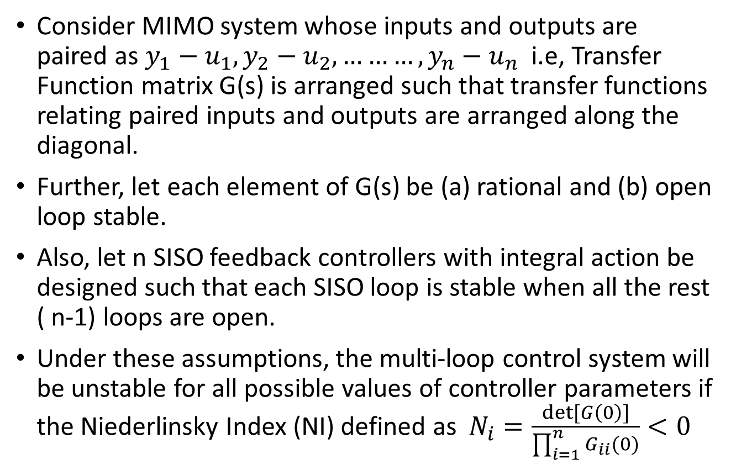
Niederlinsky Index
Consider MIMO system whose inputs and outputs are paired as $y_{1}−u_{1}, y_{2}−u_{2},………,y_{n}−u_{n}$ i.e, Transfer Function matrix G(s) is arranged such that transfer functions relating paired inputs and outputs are arranged along the diagonal.
Further, let each element of G(s) be (a) rational and (b) open loop stable.
Also, let n SISO feedback controllers with integral action be designed such that each SISO loop is stable when all the rest ( n-1) loops are open.
Under these assumptions, the multi-loop control system will be unstable for all possible values of controller parameters if the Niederlinsky Index (NI) defined as $N_{i}=\frac{det⁡[G\left(0\right)]}{\prod_{i=1}^{n}{G_{ii}(0)}}<0$

Slide 3
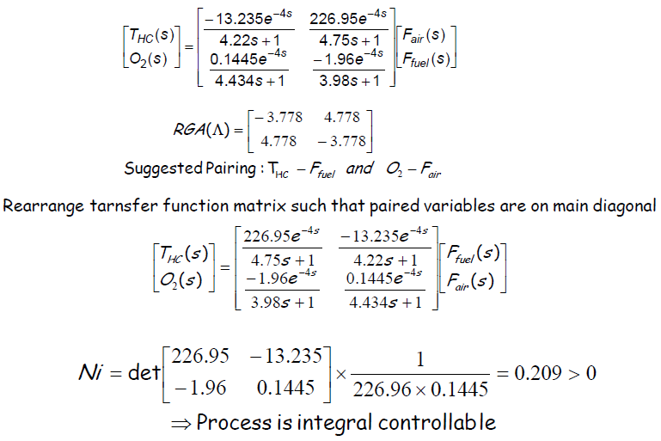
Furnace Control

Slide 4
Multi-Loop PID Control
After selection of loop pairings with minimum interactions, one can design controllers for individual loops.
Presence of interaction and retaliatory effects from other loops may require that the controller be detuned for acceptable performance.
BLT Detuning method
Sequential Loop Tuning
Independent Loop Tuning

Slide 5
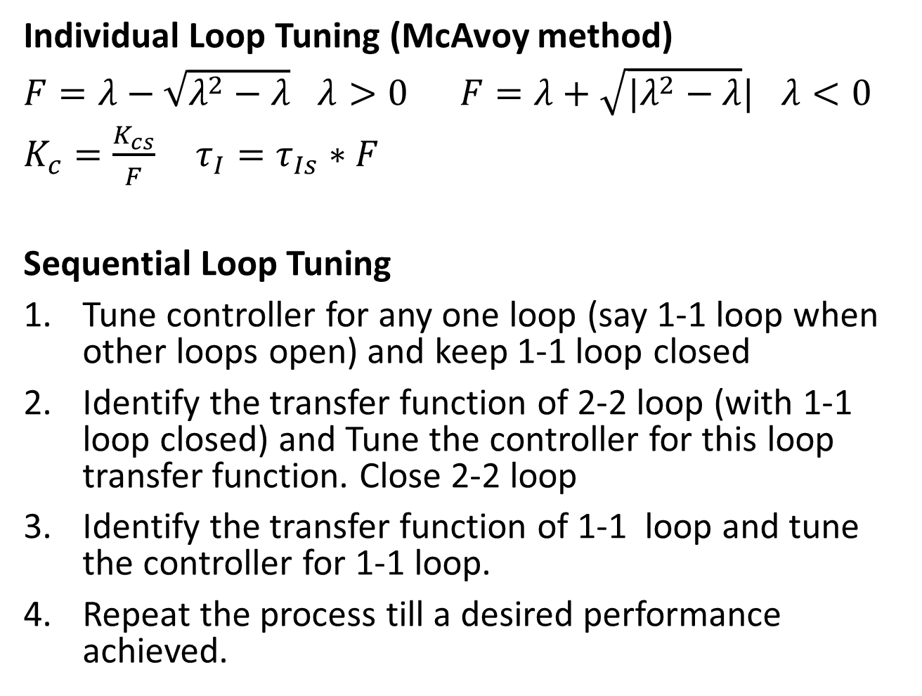
Individual Loop Tuning (McAvoy method)
$F=λ−\sqrt{λ^{2}−λ}$ $λ>0$ $F=λ+\sqrt{|λ^{2}−λ}|$ $λ<0$
$K_{c}=\frac{K_{cs}}{F} τ_{I}=τ_{Is}∗F$
Sequential Loop Tuning
Tune controller for any one loop (say 1-1 loop when other loops open) and keep 1-1 loop closed
Identify the transfer function of 2-2 loop (with 1-1 loop closed) and Tune the controller for this loop transfer function. Close 2-2 loop
Identify the transfer function of 1-1 loop and tune the controller for 1-1 loop.
Repeat the process till a desired performance achieved.

Slide 6
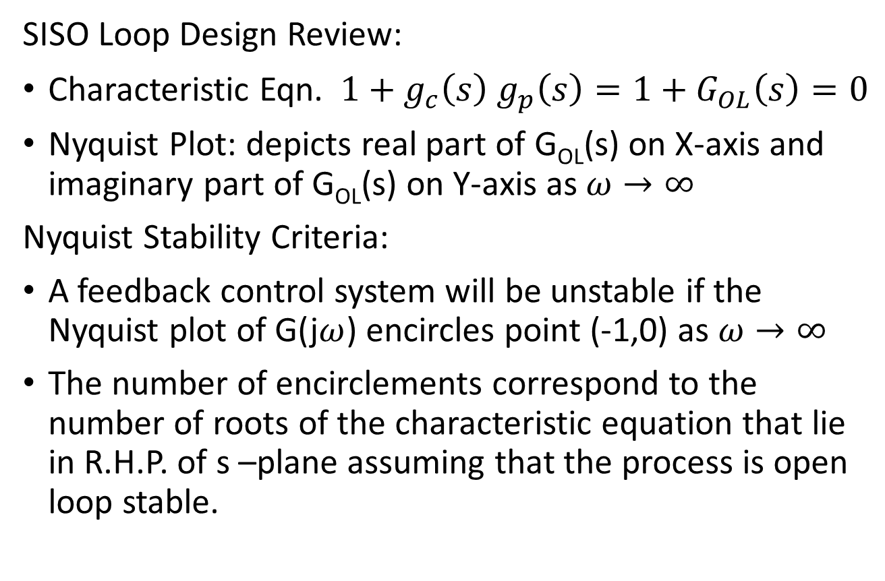
Biggest Log Modulus Tuning (BLT)
SISO Loop Design Review:
Characteristic Eqn. $1+g_{c}\left(s\right) g_{p}\left(s\right)=1+G_{OL}\left(s\right)=0$
Nyquist Plot: depicts real part of G_{OL}(s) on X-axis and imaginary part of G_{OL}(s) on Y-axis as $ω→∞$
Nyquist Stability Criteria:
A feedback control system will be unstable if the Nyquist plot of G(j$ω$) encircles point (-1,0) as $ω→∞$
The number of encirclements correspond to the number of roots of the characteristic equation that lie in R.H.P. of s –plane assuming that the process is open loop stable.

Slide 7
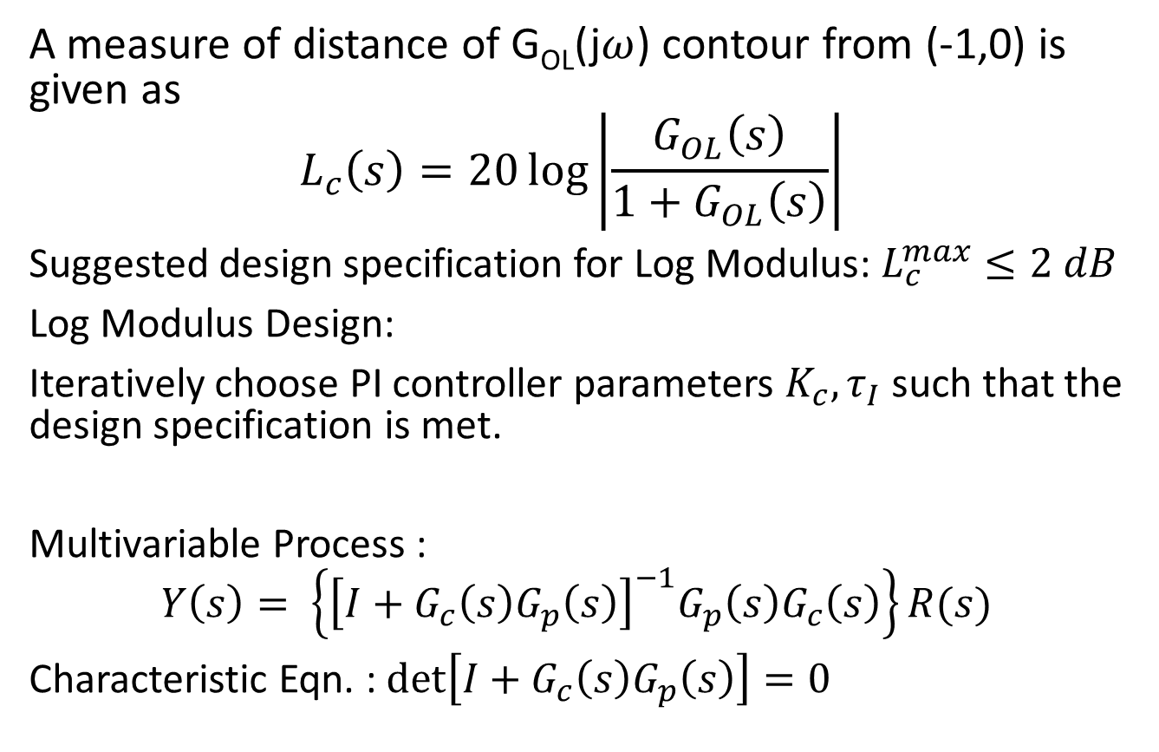
BLT Method
A measure of distance of G_{OL}(j$ω$) contour from (-1,0) is given as
$$L_{c}\left(s\right)=20\log\left|\frac{G_{OL}\left(s\right)}{1+G_{OL}\left(s\right)}\right|$$
Suggested design specification for Log Modulus: $L_{c}^{max}≤2 dB$
Log Modulus Design:
Iteratively choose PI controller parameters $K_{c}, τ_{I}$ such that the design specification is met.
Multivariable Process :
$$Y\left(s\right)= \left\{{\left[I+G_{c}\left(s\right)G_{p}\left(s\right)\right]}^{−1}G_{p}\left(s\right)G_{c}\left(s\right)\right\}R(s)$$
Characteristic Eqn. : $\det\left[I+G_{c}\left(s\right)G_{p}\left(s\right)\right]=0$

Slide 8
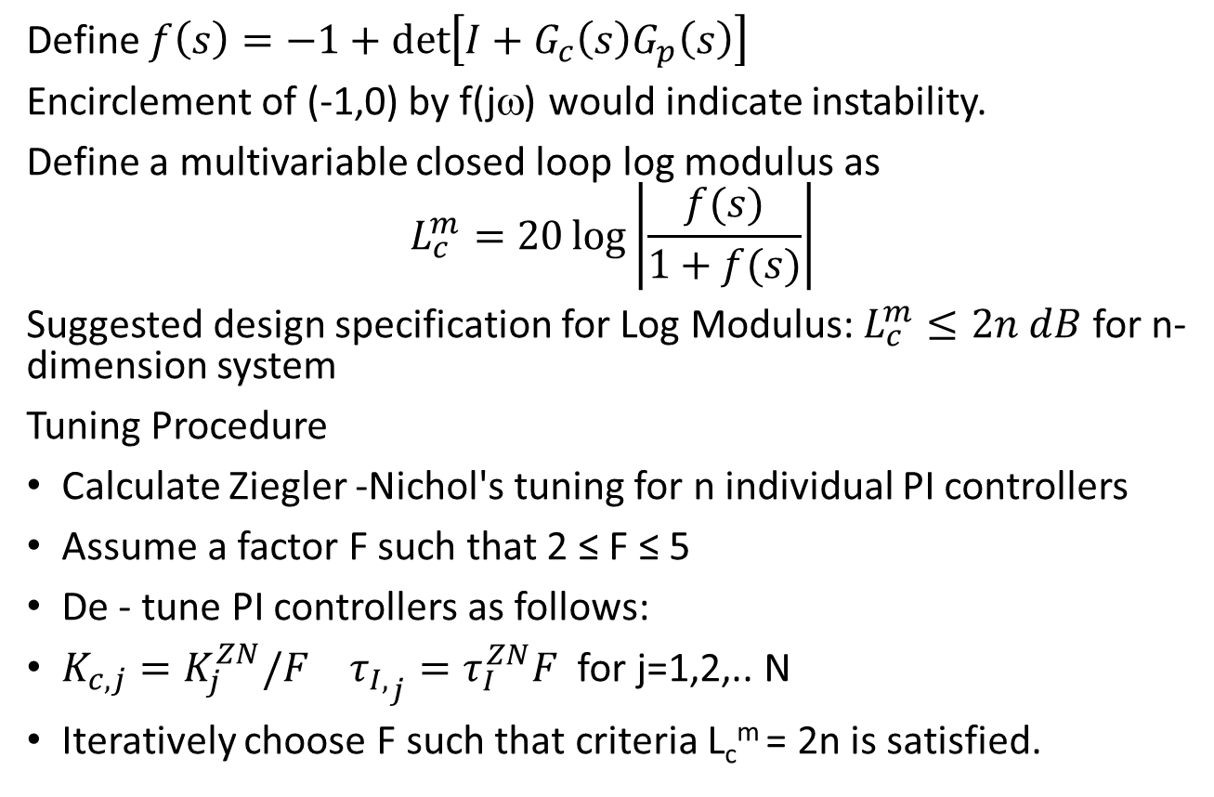
BLT Method
Define $f\left(s\right)=−1+\det\left[I+G_{c}\left(s\right)G_{p}\left(s\right)\right]$
Encirclement of (-1,0) by f(jω) would indicate instability.
Define a multivariable closed loop log modulus as
$$L_{c}^{m}=20\log\left|\frac{f(s)}{1+f(s)}\right|$$
Suggested design specification for Log Modulus: $L_{c}^{m}≤2n dB$ for n-dimension system
Tuning Procedure
Calculate Ziegler -Nichol's tuning for n individual PI controllers
Assume a factor F such that 2 ≤ F ≤ 5
De - tune PI controllers as follows:
$K_{c,j}=K_{j}^{ZN}/F$ ${τ_{I,}}_{j}=τ_{I}^{ZN}F$ for j=1,2,.. N
Iteratively choose F such that criteria L_{c}^{m} = 2n is satisfied.

Slide 9
BLT: Example

Slide 10
BLT: Example

Slide 11
BLT: Example

Slide 12
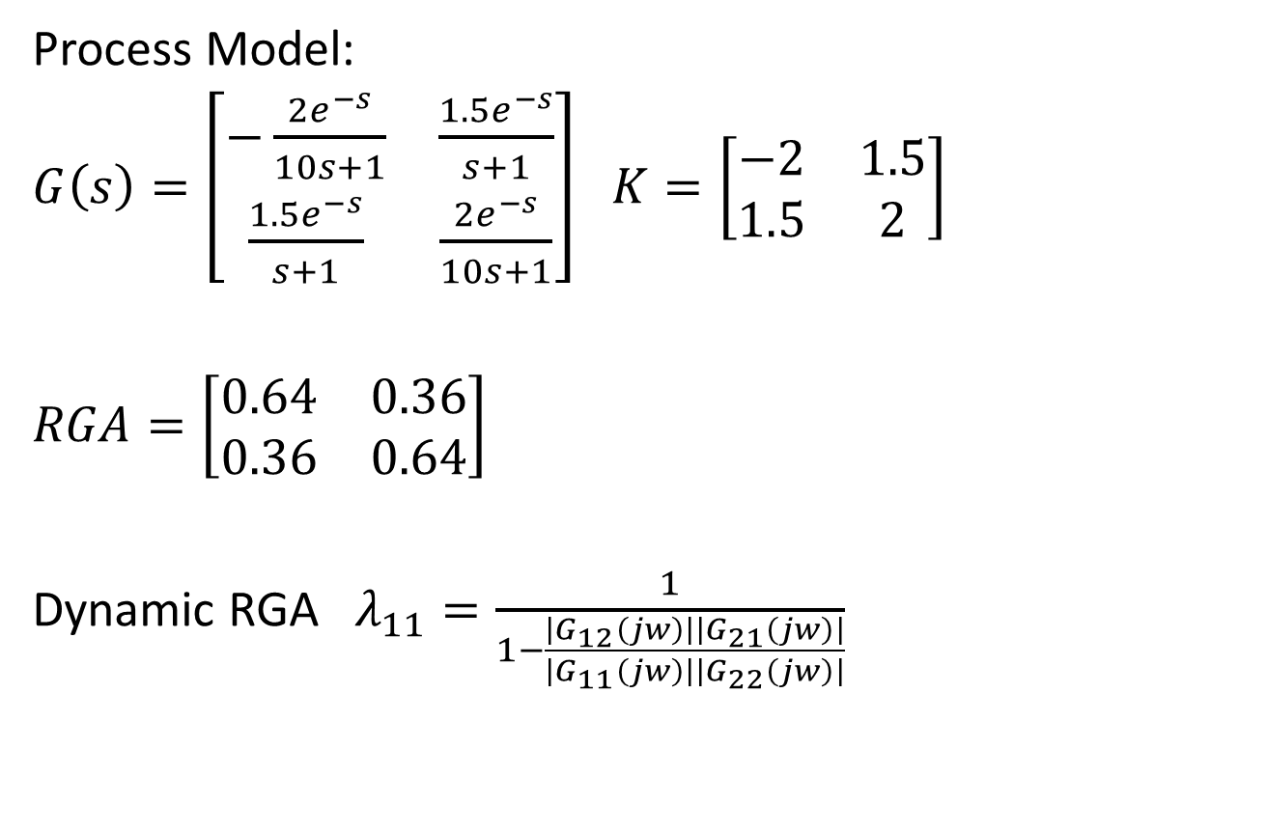
Dynamic RGA
Process Model:
$G\left(s\right)=\left[\begin{matrix}−\frac{2e^{−s}}{10s+1} & \frac{1.5e^{−s}}{s+1} \\ \frac{1.5e^{−s}}{s+1} & \frac{2e^{−s}}{10s+1}\end{matrix}\right]$ $K=\left[\begin{matrix}−2 & 1.5 \\ 1.5 & 2\end{matrix}\right]$
$RGA=\left[\begin{matrix}0.64 & 0.36 \\ 0.36 & 0.64\end{matrix}\right]$
Dynamic RGA $λ_{11}=\frac{1}{1−\frac{\left|G_{12}\left(jw\right)\right|\left|G_{21}\left(jw\right)\right|}{\left|G_{11}\left(jw\right)\right|\left|G_{22}\left(jw\right)\right|}}$

Slide 13
Principles of Decoupling

Slide 14
Block Diagram : Quad Tank

Slide 15

Simplified Decoupling
Two compensator Blocks g_{I1} and g_{I2}
Controller output v₁ and v₂
Actual control on the process u₁ and u₂
Without compensator
u₁ = v₁ and u₂=v₂
Process model :
$y_{1}=g_{11}u_{1}+g_{12}u_{2}$
$y_{2}=g_{21}u_{1}+g_{22}u_{2}$
With Compensator
Loop 2 informed of changes
of v₁ by g_{I2} and u₂ is adjusted
Same for Loop 1

Slide 16
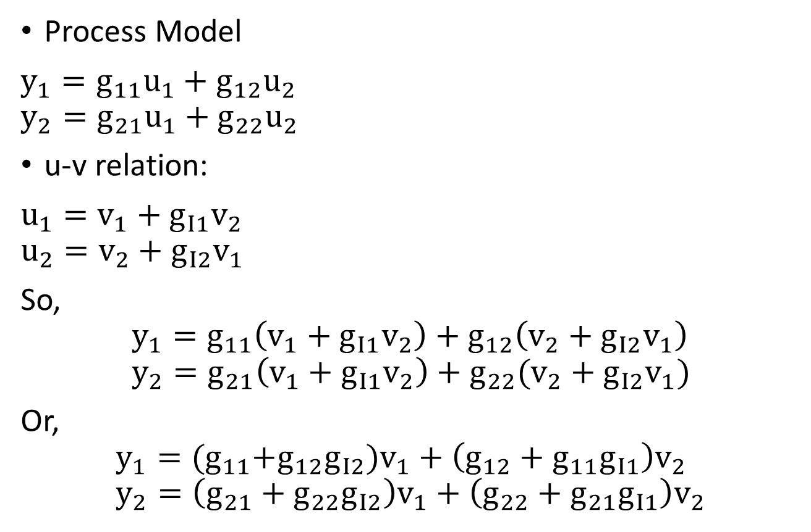
Simplified Decoupler Design
Process Model
$y_{1}=g_{11}u_{1}+g_{12}u_{2}$ $y_{2}=g_{21}u_{1}+g_{22}u_{2}$
u-v relation:
$u_{1}=v_{1}+g_{I1}v_{2}$ $u_{2}=v_{2}+g_{I2}v_{1}$
So,
$$y_{1}=g_{11}\left(v_{1}+g_{I1}v_{2}\right)+g_{12}\left(v_{2}+g_{I2}v_{1}\right) \\ y_{2}=g_{21}\left(v_{1}+g_{I1}v_{2}\right)+g_{22}(v_{2}+g_{I2}v_{1})$$
Or,
$$y_{1}={(g}_{11}+g_{12}g_{I2})v_{1}+\left(g_{12}+g_{11}g_{I1}\right)v_{2} \\ y_{2}=\left(g_{21}+g_{22}g_{I2}\right)v_{1}+\left(g_{22}+g_{21}g_{I1}\right)v_{2}$$

Slide 17
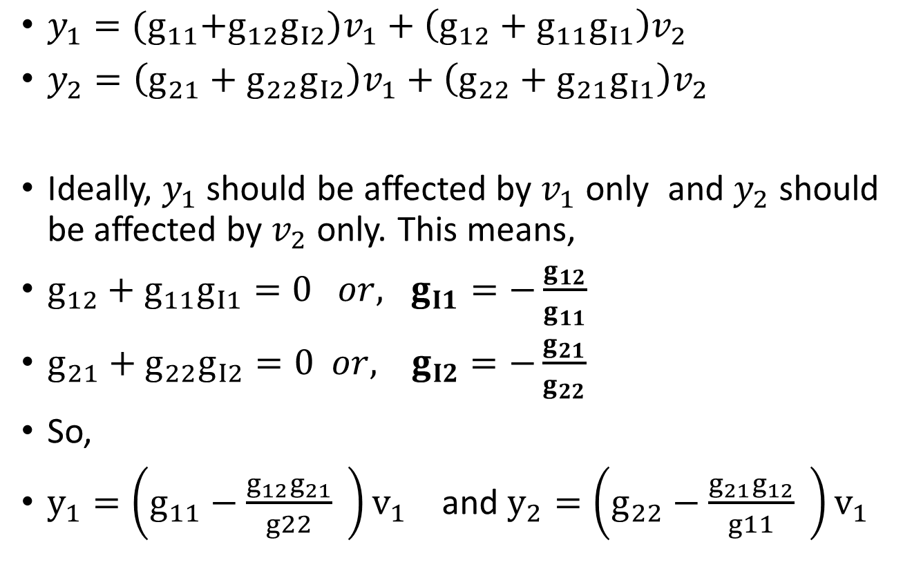
Simplified Decoupler Design
$y_{1}={(g}_{11}+g_{12}g_{I2})v_{1}+\left(g_{12}+g_{11}g_{I1}\right)v_{2}$
$y_{2}=\left(g_{21}+g_{22}g_{I2}\right)v_{1}+\left(g_{22}+g_{21}g_{I1}\right)v_{2}$
Ideally, $y_{1}$ should be affected by $v_{1}$ only and $y_{2}$ should be affected by $v_{2}$ only. This means,
$g_{12}+g_{11}g_{I1}=0 or, g_{I1}=−\frac{g_{12}}{g_{11}}$
$g_{21}+g_{22}g_{I2}=0 or, { g}_{I2}=−\frac{g_{21}}{g_{22}}$
So,
$y_{1}=\left(g_{11}−\frac{g_{12}g_{21}}{g22} \right)v_{1}$ and $y_{2}=\left(g_{22}−\frac{g_{21}g_{12}}{g11} \right)v_{1}$

Slide 18
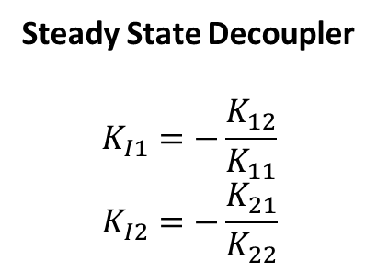
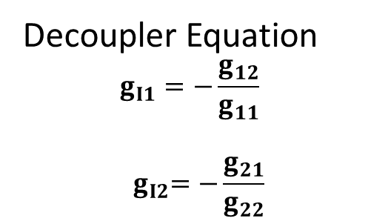
Simplified Decoupler Design
Decoupler Equation
$$g_{I1}=−\frac{g_{12}}{g_{11}}$$
$${ g}_{I2}=−\frac{g_{21}}{g_{22}}$$
Steady State Decoupler
$$K_{I1}=−\frac{K_{12}}{K_{11}} \\ K_{I2}=−\frac{K_{21}}{K_{22}}$$

Slide 19
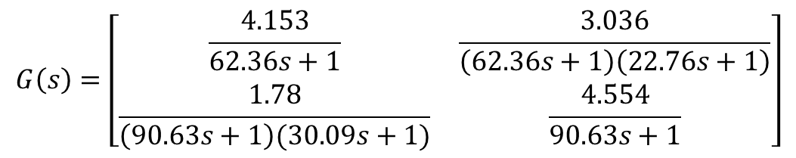
Quad tank : Decoupler Design
$$G\left(s\right)=\left[\begin{matrix}\frac{4.153}{62.36s+1} & \frac{3.036}{\left(62.36s+1\right)\left(22.76s+1\right)} \\ \frac{1.78}{\left(90.63s+1\right)(30.09s+1)} & \frac{4.554}{90.63s+1}\end{matrix}\right]$$
Steady State Decoupler : $K_{I1}=−\frac{3.036}{4.153}=−0.731$ $K_{I2}=−\frac{1.78}{4.554}=−0.391$

Slide 20

Quad tank : Decoupler Design
Full Decoupler : $g_{I1}=−\frac{0.731}{22.76s+1}$ $g_{I2}=−\frac{0.391}{30.09s+1}$

Slide 21
Example: Wood Berry Distillation Column

Slide 22
Difficulties in simplied Decoupler design

Slide 23
Generalized Decoupler Design

Slide 24
Example: Wood Berry Distillation Column

Slide 25
Steady State Decoupler Design

Slide 26
Example: Wood Berry Distillation Column

Slide 27
Simplified Vs Generalized Decoupler

Slide 28
Challenges in Decoupler Design

Slide 29
Challenges in Decoupler Design

Slide 30
Example Problem

Slide 31
Example Problem
Alternate Solution

Slide 32
Partial Decoupling

Slide 33
Partial Decoupling Example

